Slide 1

HOSTING IN NEW YORK WITH AIRBNB
-Based on NYC Airbnb Open data
GROUP 09
Chamodi Perera S13566
Migara Devinda S13370
Sathsara Rasantha S13630
Notes:
To change the image on this slide, select the picture and delete it. Then click the Pictures icon in the placeholder to insert your own image.

Slide 2

About Airbnb…
An online market place
Connects people who rent out their homes with people who are looking for accommodation
Started in 2008,in California with 2 hosts and 3 guests
Currently offers over 5 million listings

Slide 3
About the data set…
Variable | Description
id | ID of the listing
name | Name of the listing
host_id | ID given to the host
host_name | Name of the host
neighbourhood_group | The borough in which the listing is located
neighbourhood | The sub-city in which the listing is located
latitude | Latitude coordinates
longitude | Longitude coordinates
16 variables
48895 observations

Slide 4
About the data set…
Variable | Description
room_type | Listing space type: home/apartment, shared room, private room
price | Price per night demanded by the host
minimum_nights | Minimum number of nights that the listing should be booked
number_of reviews | Number of reviews in the website for the listing
last_review | Date of the last review for the listing
reviews_per_month | Number of reviews per month
calculated_host_listings_count | Total number of listings owned by the host
availability_365 | Number of days which the listing is available for booking

Slide 5
Objective
Price is the only predictable variable
Price is the amount of money per night demanded by the host from a guest and Airbnb doesn’t involve in determining this price
It makes sense to suggest a price that will keep them in the business to the hosts when uploading a new listing based on the location and other factors about the listing.
Thus our objective:
“Providing the hosts with an estimate on the amount they could earn per night from their listing”

Slide 6
The Way We Hope to Answer the Question
Understanding the variables
Descriptive analysis
Advanced Analysis
Developing the data product

Slide 7

Into the data set…

Slide 8
Missing Values…
Variable | No. of missing values | Explanation
name | 16 | Name is not uploaded to the website originally
host_name | 21 | Names of 18 listings could be found from the website. The other listings have been removed from the website
last_review | 10052 | There are no reviews for the listing
reviews_per_month | 10052 | There are no reviews for the listing

Slide 9


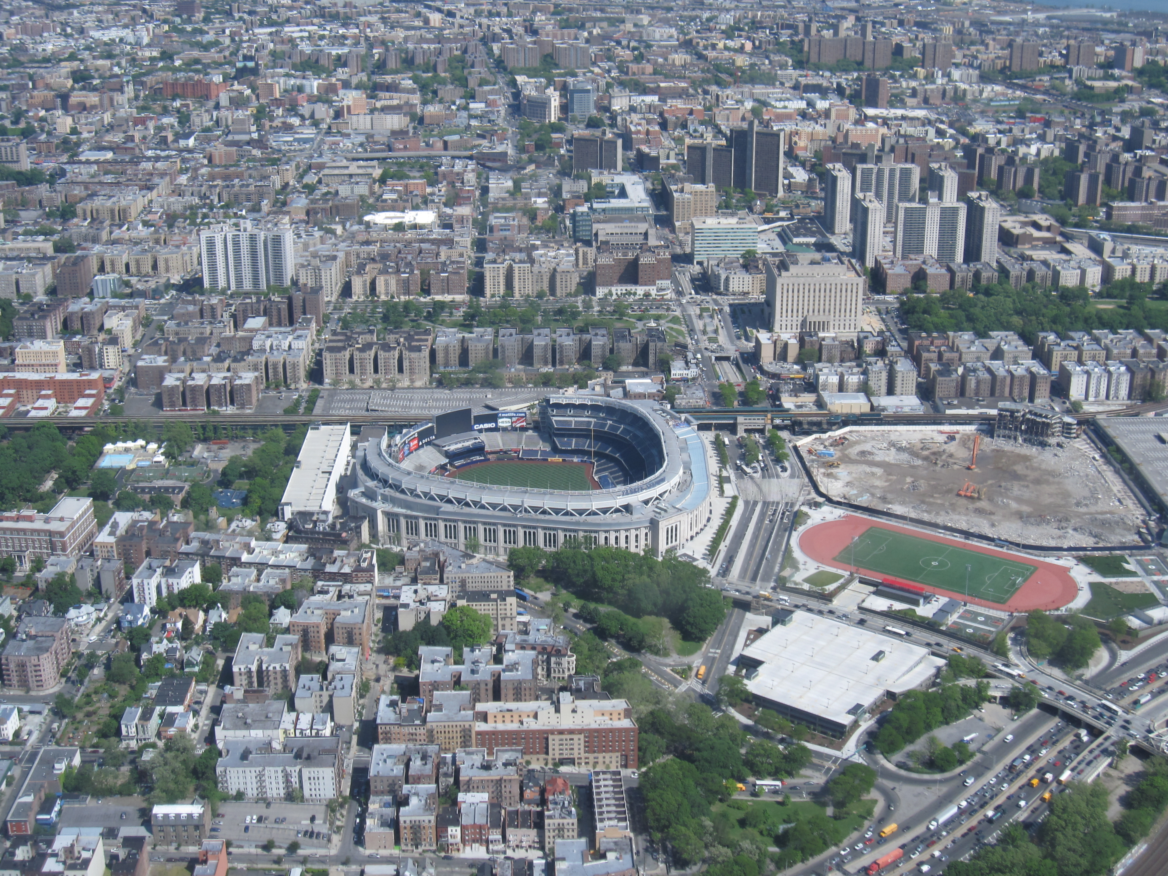



Slide 10
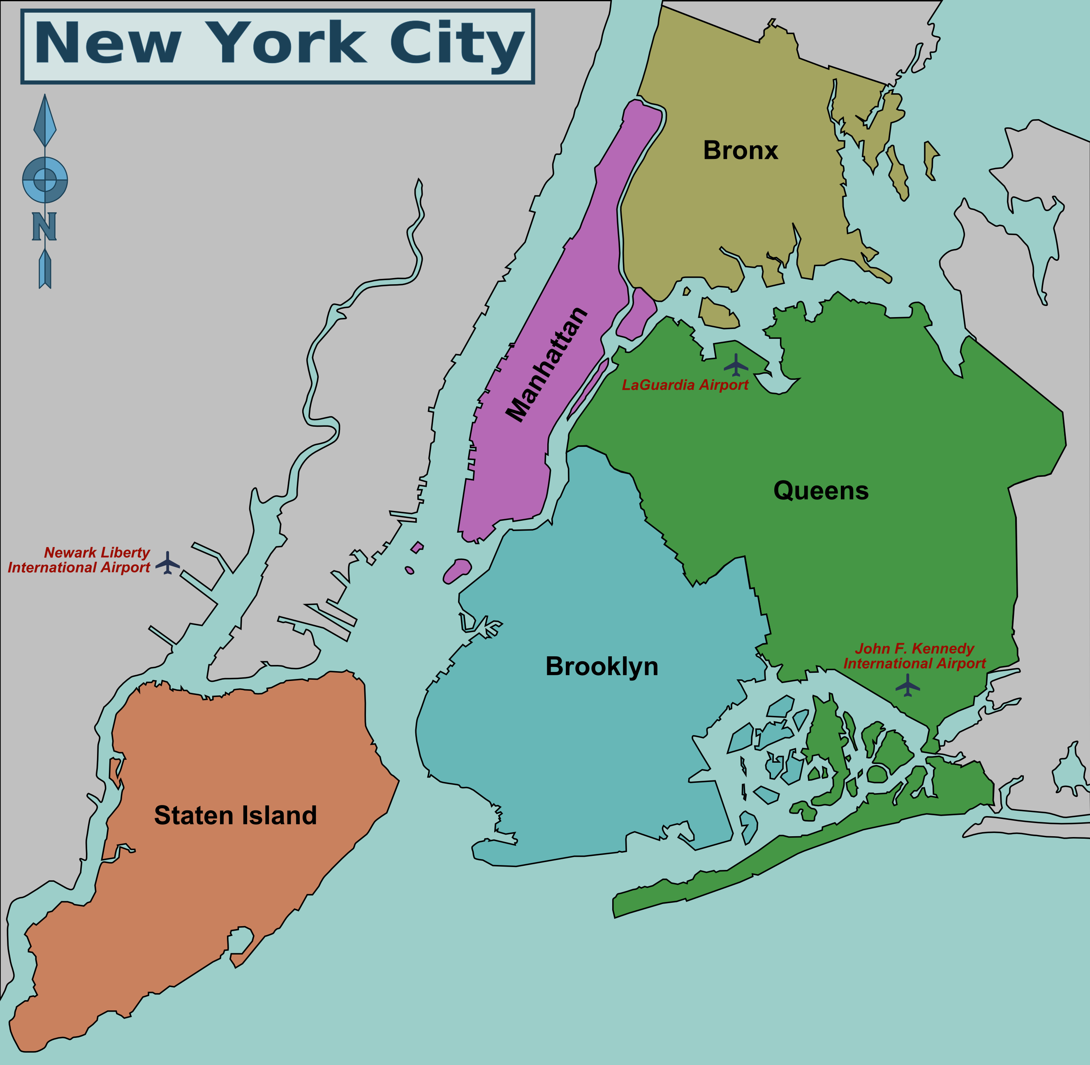
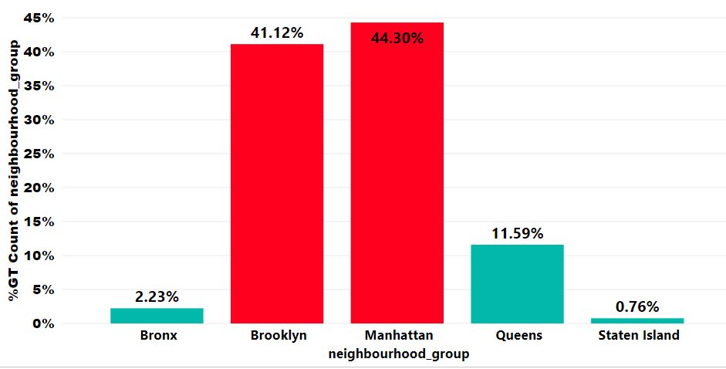
The Five Boroughs in New York
Percentage of listings by borough

Slide 11
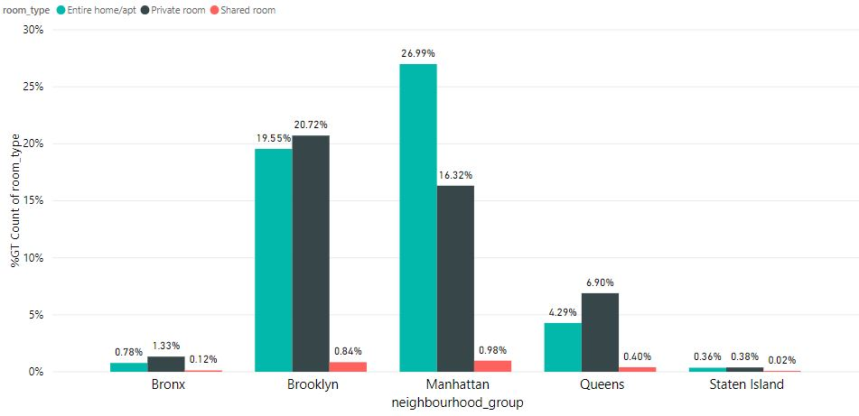
Room Type by Borough

Slide 12
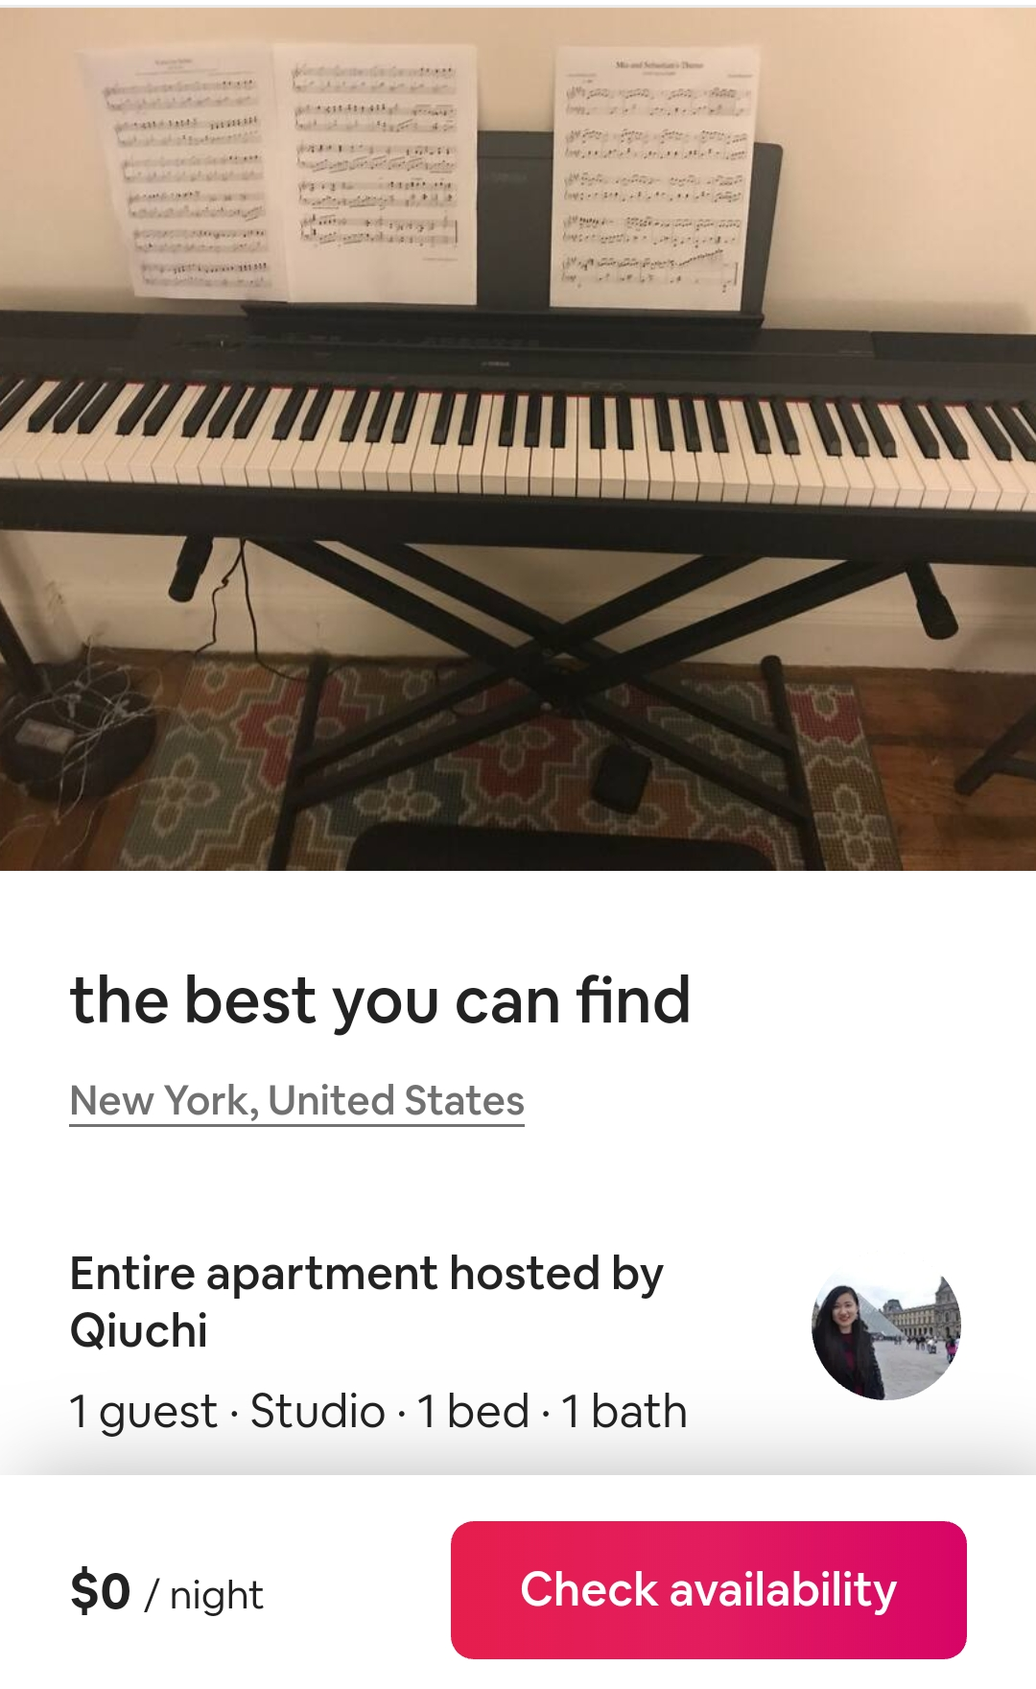
Price
There were 11 listings with price = $0
Tracked the listings using listing id
10 out of 11 had their price in the website
Discarded the remaining listing with price = 0

Slide 13
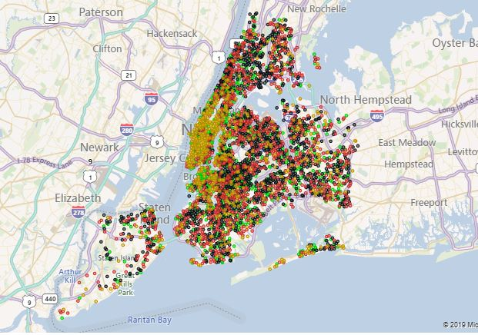
Price Vs Borough
Very High Medium
High Low
Minimum | $10
25% | $69
50% | $106
75% | $175
Maximum | $10000

Slide 14
Price Vs Room Type

Slide 15
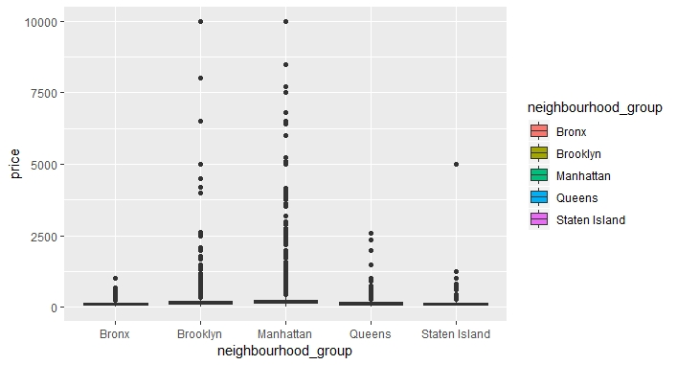
Price of Apartments

Slide 16
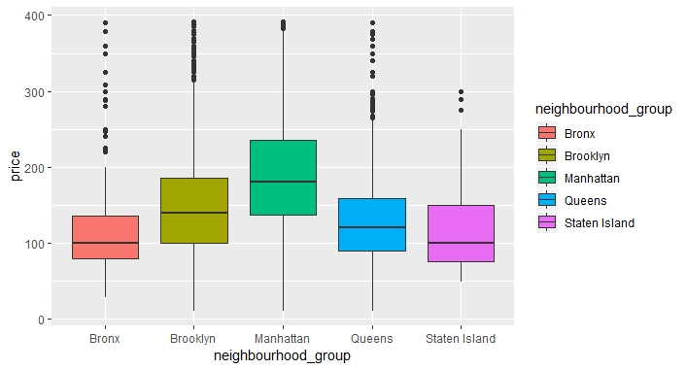
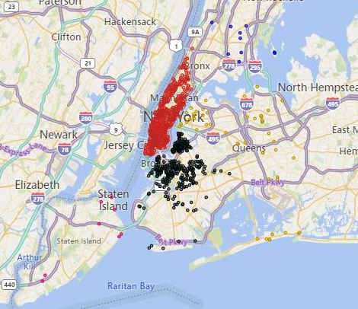
Outlying Prices of Apartments and the Price by Borough without outliers
Outlying Prices
Price by borough after removing outliers

Slide 17
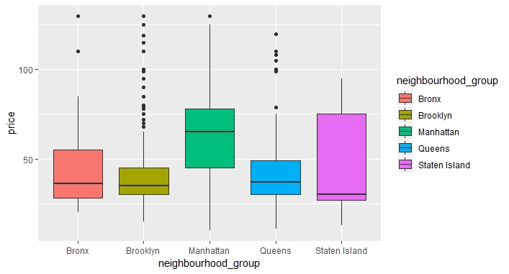
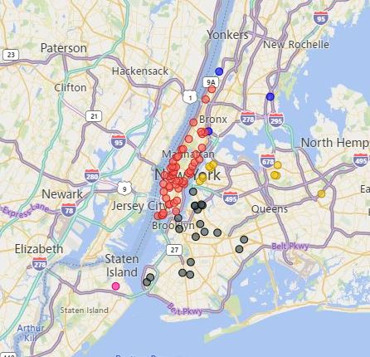
Outlying Prices of Shared Rooms and the Price by Borough without outliers
Outlying Prices
Price by borough after removing outliers

Slide 18
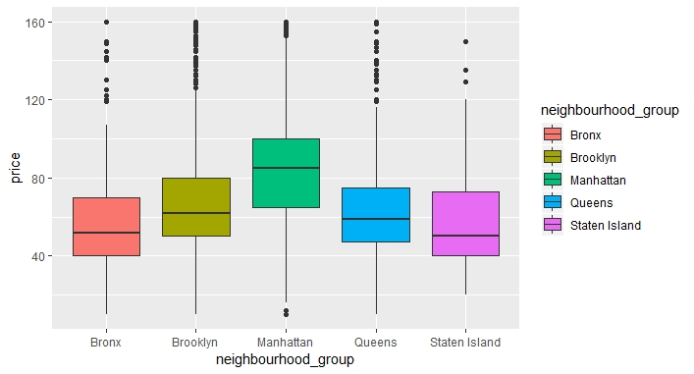
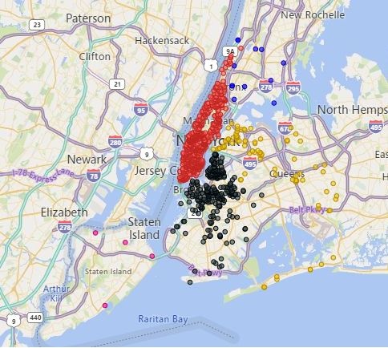
Outlying Prices of Private Rooms and the Price by Borough without outliers
Outlying Prices
Price by borough after removing outliers

Slide 19
Shared Rooms
Apartments
Private Rooms

Slide 20
Top 10 Locations with Outlying Prices for Each Room Type in Manhattan
Entire home/Apartment | Shared Rooms | Private Rooms
Midtown | Hell’s Kitchen | Midtown
Hell’s Kitchen | Upper West Side | Hell’s Kitchen
Upper West Side | Chelsea | Upper West Side
Chelsea | Upper East Side | East Village
East Village | Financial District | Harlem
Upper East Side | Harlem | Chelsea
West Village | East Harlem | Upper East Side
Soho | Little Italy | Financial District
Financial District | Lower East Side | Theater District
Tribeca | East Village | Lower East Side

Slide 21





Midtown
Upper West Side
Chelsea and Hell’s Kitchen
Financial District
Harlem

Slide 22
Top 10 Locations with Outlying Prices for Each Room Type in Brooklyn
Entire home/Apartment | Shared Rooms | Private Rooms
Williamsburg | Williamsburg | Williamsburg
Bedford-Stuyvesant | Bedford-Stuyvesant | Bedford-Stuyvesant
Crown Heights | East New York | Green Point
Clinton Hill | Flatbush | Clinton Hill
Park Slope | Bay Ridge | Bushwick
Green Point | Crown Heights | Crown Heights
Prospect Heights | Fort Greene | Park slope
Fort Greene | Fort Hamilton | East Flatbush
Brooklyn Heights | Green Point | Flatbush
Bushwick | Kensington | Prospect Heights

Slide 23
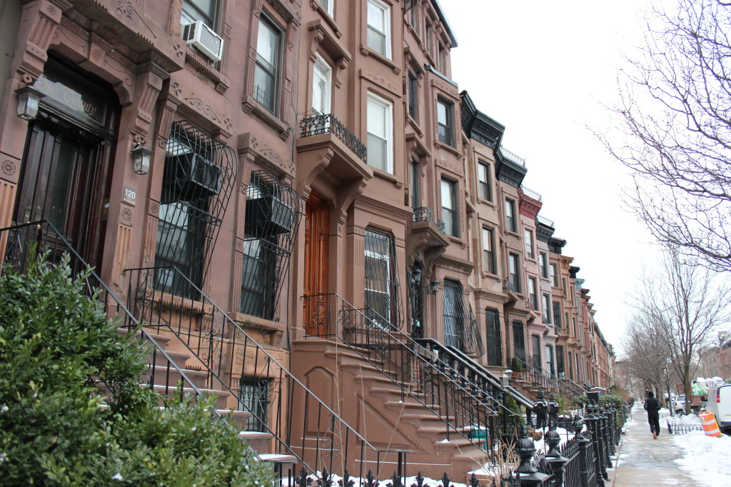


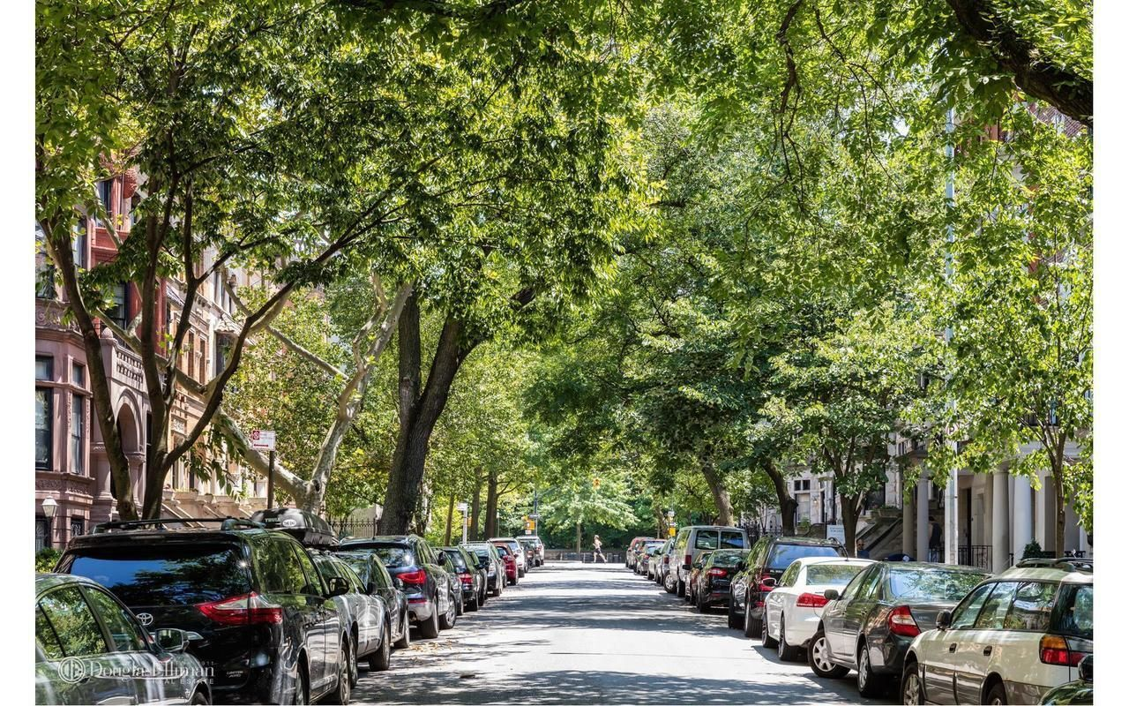

Williamsburg
Bedford-
Stuyvesant
Crown heights
Flatbush
Park Slope

Slide 24
Top 10 Locations with Outlying Prices for Each Room Type in Queens
Entire home/Apartment | Shared Rooms | Private Rooms
Flushing | Astoria | Long Island City
Long Island City | Flushing | Astoria
Astoria | Long Island City | Elmhurst
Arverne | Bellerose | Ditmars Steinway
Jamaica |  | Jamaica
Far Rockaway |  | Flushing
Forest Hills |  | Breezy Point
Woodside |  | Briarwood
Bayside |  | Woodside
Briarwood |  | Arverne

Slide 25




Astoria Park
Flushing
Jamaica
Long Island City

Slide 26
Association of the Year of Last Review with Price
ANOVA
Last Review | No. of listings
No reviews | 10051
Last 06 months | 25209
One year back | 6050
Two years back | 3205
Three years back | 2707
Four years back | 1393
Five years back | 199
Six or more years back | 80
SOV | Degrees of freedom | Sum of Squares | Mean Square | F-ratio | P-value
Year | 7 | 2.175e+07 | 3106514 | 54.28 | <2e-16
Residuals | 48886 | 2.798e+09 | 57235
The year in which the last review has been made has a significant effect on the price of the listing.

Slide 27
Year of the Last Review…
Results from Dunnett’s Modified Tukey-Kramer Pairwise Multiple Comparison Test
Significant differences could be found in the prices among the following categories
Older reviews has the same effect on the listing price as zero reviews….
No reviews | Last 6 months
No reviews | One year back
No reviews | Two years back
No reviews | Three years back
No reviews | Four years back

Slide 28
No. of Listings a Host Owns Vs Price
ANOVA
SOV | Degrees of Freedom | Sum of Squares | Mean Square | F ratio | P-value
Host listing count | 2 | 1.312e+07 | 6560170 | 114.3 | <2e-16
Residuals | 48890 | 2.807e+09 | 57408
Host listings category | Count
1 | 32302
2-50 | 15220
More than 50 | 1372
No. of listings a host owns has a significant effect on the price of the listing.

Slide 29


No. of Listings a Host Owns
Results from Dunnett’s Modified Tukey-Kramer Pairwise Multiple Comparison Test
Significant differences could be found in the prices among all the categories
There’s a significant effect on the price of a listing when a host owns more than one listing

Slide 30
Correlation between Predictor Variables
 | Borough | Year of last review | Host group | Room type
Borough | - | 0.0606 | 0.1368 | 0.1263
Year of last review |  |  | 0.1711 | 0.0316
Host group |  |  |  | 0.1943
Room
Chi-square test was applied to check if the variables are not independent
Cramer’s V statistic was calculated to get an idea about the correlation

Slide 31
Suggestions For Advanced Analysis
Ridge Regression
Lasso Regression
Elastic Net Regression
Support Vector Regression

Slide 32
References
https://www.airbnb.com/help/article/125/how-is-the-price-determined-for-my-reservation
https://www.airbnb.com/help/article/125/how-is-the-price-determined-for-my-reservation
https://blackdemographics.com/cities-2/new-york-nj-ny/
https://www.google.com/amp/s/www.extraspace.com/blog/moving/city-guides/best-boroughs-nyc/amp/
https://www.google.com/amp/s/www.seathecity.com/nyc-tourism-facts-statistics/amp/
http://www.noahsarkinc.com/blog/comparing-the-5-boroughs-of-nyc/
https://www.kaggle.com/chirag9073/airbnb-analysis-visualization-and-prediction
https://www.kaggle.com/darkrubiks/nyc-airbnb-exploratory-analysis
https://www.airbnb.com
https://cran.r-project.org/web/packages/DTK/index.html
https://medium.com/@outside2SDs/an-overview-of-correlation-measures-between-categorical-and-continuous-variables-4c7f85610365
https://www.youtube.com/watch?v=8EMW7io4rSI
https://www.kaggle.com/dgomonov/data-exploration-on-nyc-airbnb
https://www.comparably.com/companies/airbnb/mission
https://arxiv.org/abs/1907.12665
https://www.tripsavvy.com
http://www.nycgo.com
http://www.nytimes.com/2015/06/21/realestate/crown-heights-Brooklyn-where-stoop-life-still-thrive.html
http://www.worldstrides.com
https://www.kaggle.com/alvaroibrain/airbnb-data-analysis

Slide 33

THANK YOU …

